Slide 1
Manually Entering Your Data into EUDAMED?
ACKOMAS Webinars Ackomas 2/8
Q1-2025 – Thursday, January 30 2025
English Version
Notes:
Hi everyone, and thanks for joining us for the second Ackomas Webinar of the year.
Today, we're going to dive into one of the three approaches for registering medical devices in the EUDAMED regulatory database, specifically in the UDI/DEV (DEVICES) module. So, let's get started with the first approach: “direct entry into EUDAMED.'

Slide 2
Q1-2025 Ackomas Webinars (2/8) Your Subject Matter Expert
ACKOMAS is a software publisher
Expert in Regulatory Compliance
Dedicated to the Medical Device industry
M2M solution for EUDAMED, operational since 2021, and
for other existing (GUDID) and upcoming regulatory databases
ACKOMAS is a partner of
MEDTECH Europe
GS1Healthcare
ISPE (international Society for Pharmaceutical Engineering)
Jean-Philippe Joubert Email: jpjoubert@ackomas.com
www.ackomas.com
2
2
Notes:
For those who didn't attend the webinar titled 'EUDAMED Project: Understanding the Essentials,' my name is Jean-Philippe Joubert. I'm the Head of Customer Success at Ackomas.
Over the past 10 years, I've been the Director of Studies at the IT department of a medical device manufacturing group. During that time, I managed a global product reference program, which included projects for building e-catalogs for purchasing groups and publishing to regulatory databases like GUDID, NHS (before Brexit), and EUDAMED.
I'm passionate about sharing and comparing my experience with yours. I'll give you an honest perspective, though I should mention that a manual solution was never adopted at my previous company; we always used a machine-to-machine approach, just like Ackomas, a leader in this market.
Ackomas is not just any software company. It's dedicated to healthcare, particularly the medical device industry and regulatory compliance. Its founders are recognized experts in the pharmaceutical and medical device fields.
Ackomas is a partner of MEDTECH Europe, and I personally attend the meetings in Brussels. The company is also a partner of GS1 Healthcare and ISPE, which is well-known for its GAMP5 and Data Integrity publications

Slide 3
Q1-2025 Ackomas Webinars (2/8) Your webinars on Q1-2025 about EUDAMED
Regular and Operational Exchanges among us
# | List of Ackomas Webinars for Q1-2025 | Dates
1 | EUDAMED Project : Understanding the Essentials | Jan 23, 25 3pm
2 | Manually Entering Your Data into EUDAMED? | Jan 30, 25 3pm
3 | Uploading XML files into EUDAMED? | Feb 13, 25 3pm
4 | Processing EUDAMED Updates with an M2M Solution | Feb 27, 25 3pm
5 | Who is Interested in EUDAMED within the Company? Who leads? | Mar 13, 25 3pm
6 | Global challenges of Regulatory Databases | Mar 27, 25 3pm
7 | EUDAMED vs GUDID | Apr 10, 25 3pm
8 | EUDAMED Budget: How to Plan & Optimize Your Expenses | Apr 24, 25 3pm
3
3
Notes:
This second webinar is titled “Manually entering your data into EUDAMED”.
It logically follows last week's webinar, where we discussed some characteristics of an EUDAMED project in 2025. Among them were two key areas (remember?): Data Collection & EUDAMED Data Publication.
Today's webinar is the second in a series of 8 webinars, all in English, happening every other Thursday starting today, at 3 PM (CET) during the first half of 2025.
We've designed them to be 20 to 30 minutes each to get straight to the point.
This webinar assumes you have a basic understanding of EUDAMED and concepts like Basic UDI-DI or UDI-DI.
You can ask general questions in the Teams chat tab or contact our Ackomas representatives later for more specific discussions about your case.

Slide 4
Webinar 2/8 : Manually Entering Your Data into EUDAMED? Webinar Objectives
11 months Before the First EUDAMED Deadline
Identify cases where manual data entry should not be overlooked
Critically examine manual data entry in EUDAMED
Share some experiences
Question the viability of the manual EUDAMED solution
Identify alternative solutions to manual data entry
Notes:
These webinars come at a crucial time as we're just 11 months away from the first EUDAMED deadline.
Today's webinar will mainly focus on:
Identifying cases where manual entry shouldn't be overlooked
Critically examining manual entry in EUDAMED
Sharing some experiences
Questioning the viability of the manual EUDAMED solution
Identifying alternative solutions to manual entry

Slide 5
Webinar 2/8 : Manually Entering Your Data into EUDAMED? Key Conditions
Key
Conditions
Main Disadvantages
Limited quantity of Medical Devices
Main
Advantages
No investment required
Internal EUDAMED expertise vs. Consulting costs
Limited quantity of basic UDI-DIs (<100)
Few new products and few major modifications
Small companies
Few distributed markets
Immediately usable once registered in the Actors module
Availability & loyalty of dedicated resources
Risk of data entry errors and re-labeling
Data update and management vs. Market conditions
Traceability and compliance vs. Audits by Notified Bodies or Regulatory Authorities
Only a few SMEs with a low volume of medical devices have a financial interest in manual data entry directly on the EUDAMED platform.
Notes:
I wanted to start this webinar by getting straight to the point and mentioning the essential conditions for direct entry into EUDAMED. These conditions aren't just my whim; they're based on experience and feedback from IT directors and regulatory affairs managers.
Direct entry into EUDAMED and its production environment can only be considered if the following conditions are met:
You're dealing with a limited number of medical devices. This is usually the case when one person, often the regulatory affairs manager, can handle the technical files, data collection, and entry alone. However, it's not ideal for this low-value-added task to occupy their entire day.
You don't exceed around 100 UDI-DIs (or 100 GTINs for those using GS1 coding). Remember, the volume of medical devices isn't the same as the volume of UDI-DIs. Often, a multiplier of 2 or 3 is applied when adding UDI-DIs related to packaging.
I'd add three more conditions that could make this approach tricky if they change over time:
Not having new products or only a few and not having to manage major changes or only a few: These points would lead to the creation of new UDI-DIs.
Not planning to enter markets outside the European Union that require similar publications.
Not being in a rigorous quality approach, as manual entry would make it difficult, if not uncertain.
The main advantages of manual entry are the lack of financial investment and an immediately accessible solution. General management, for some reason, underestimates the time needed for data collection and entry. They also believe their data is always excellent quality (quality meaning conforming to definitions and rules, not necessarily accurate).
Now, let's look at the disadvantages:
The first is the need to acquire EUDAMED knowledge internally, unless you hire consultants. This knowledge needs to be documented, and since the EUDAMED database evolves, you need to maintain a minimal watch.
The second concerns the resources themselves. I've noticed high turnover in the medical device industry, especially among project/product managers and regulatory affairs personnel. These people often have high academic qualifications and won't stay if you ask them to do low-value-added tasks for too long.
The third is inherently linked to data entry and isn't unique to EUDAMED. Manual entry always means entry errors. In the past, with GUDID, some even had to relabel their products.
The next two disadvantages are related to the risks involved: poor data updates can lead to market bans and non-compliance issues during audits by notified bodies or regulatory authorities. We could talk about the first audit feedback from the FDA regarding GUDID, but that's another topic.
In short, some small and medium-sized companies with a low volume of medical devices might have a financial interest in manual entry directly on the EUDAMED platform.

Slide 6
Webinar 2/8 : Manually Entering Your Data into EUDAMED? Some prerequisites for manual data entry
Complexité
1.3
Identifier
Sources
A complex preparatory work is required.
Elevée
1.2
Etablir
Dictionnaire
1.4
Collecter données
1.1 Comprendre
Périmètre
Understand the scope of EUDAMED
Train on the EUDAMED platform (playground)
Collect EUDAMED data in an Excel file (?)
Validate the data entered in Excel
Describe governance, processes, and procedures
Identify the company in the EUDAMED Actors module
Normale
2.2
Mettre en œuvre Solution M2M
3.1
Installer
SSO
3.2
Valider solution
(qualité)
3.3
Utiliser Workflow
2.4 Publier données EUDAMED
3.4 Récupérer AR
EUDAMED
2.1
Evaluer
nbr UDI-DI
Faible
2.3
Utiliser Excel EUDAMED
T
These prerequisites are not optional; the volume of devices makes them less tedious, but the absence of template Excel files makes the project's success more uncertain
Notes:
I've just outlined the conditions, advantages, and disadvantages of manual entry into EUDAMED.
Some of you might be skeptical about these conditions, so I encourage you to try direct entry into EUDAMED yourselves if you have the time.
However, understand that these conditions apply only if you don't accept a significant degradation of your standards or values. Otherwise, anything is possible, with corresponding consequences.
Let me take a step forward and show you how I arrived at these conditions, advantages, and disadvantages.
First, let's look at the prerequisites for such entry, because you can't just enter data into EUDAMED on a whim... maybe for testing, but not in real life, not in production.
There's one important prerequisite, regardless of the approach: understanding the scope of EUDAMED. There are real questions to consider, such as creating SRNs in the Actors module and potentially creating new UDI-DIs to comply with EUDAMED rules. For example, do you know the EUDAMED rule that prohibits duplicate UDI-DIs in higher packaging level declarations, which might require you to create new UDI-DIs for EUDAMED?
Let's look at the other prerequisites specific to the direct approach:
Training on the EUDAMED platform (playground)
Collecting EUDAMED data in a dedicated Excel file. Why? Because the Excel file provided by EUDAMED isn't usable, and you can't enter data into EUDAMED without support. You'll understand why shortly.
Validating the data entered in Excel, especially if you give this task to a temp or an intern. This is from experience!
Describing the governance, process, and procedures followed
Identifying the company in the EUDAMED Actors module. This step should have been completed for most medical device companies by now.
In summary, I'm talking about the most basic approach, data entry, but you can see that it involves prerequisites that are hardly optional.

Slide 7
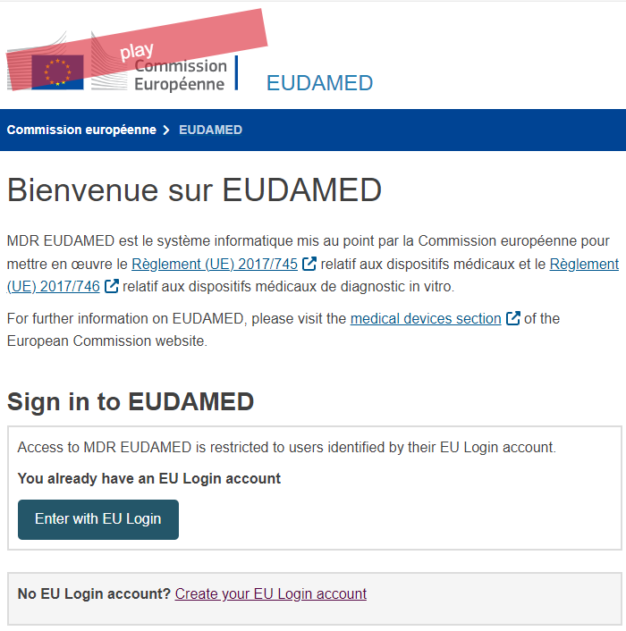
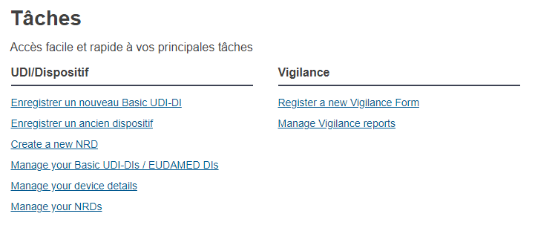
Webinar 2/8 : Manually Entering Your Data into EUDAMED? Step 1: Register on the EUDAMED platform
A delicate mix of roles often observed in SMEs
The role of the data entry operator, an unenviable role with little added value
Enter the data
Ensure the accuracy of the entered data
Maintain a record of modifications and updates made
The data coordinator often acts as the data entry operator
Notes:
With the prerequisites given and assumed to be completed...
You need to register as a data entry operator on the playground environment (to practice safely) and on the production environment. I'm not talking about the Actors module and the four types of actors, right?
This is a relatively quick activity since it starts from the EUDAMED platform and involves an exchange between your EUDAMED administrator (yours) and yourself.
We'll cover roles and responsibilities, and more broadly, governance around EUDAMED and product data governance in another webinar. That's not the focus of today's webinar.
For today's topic, two roles are involved besides the EUDAMED administrator:
The data steward
The data entry operator
Often, and I think some of you will relate, these two roles are performed by the same person

Slide 8
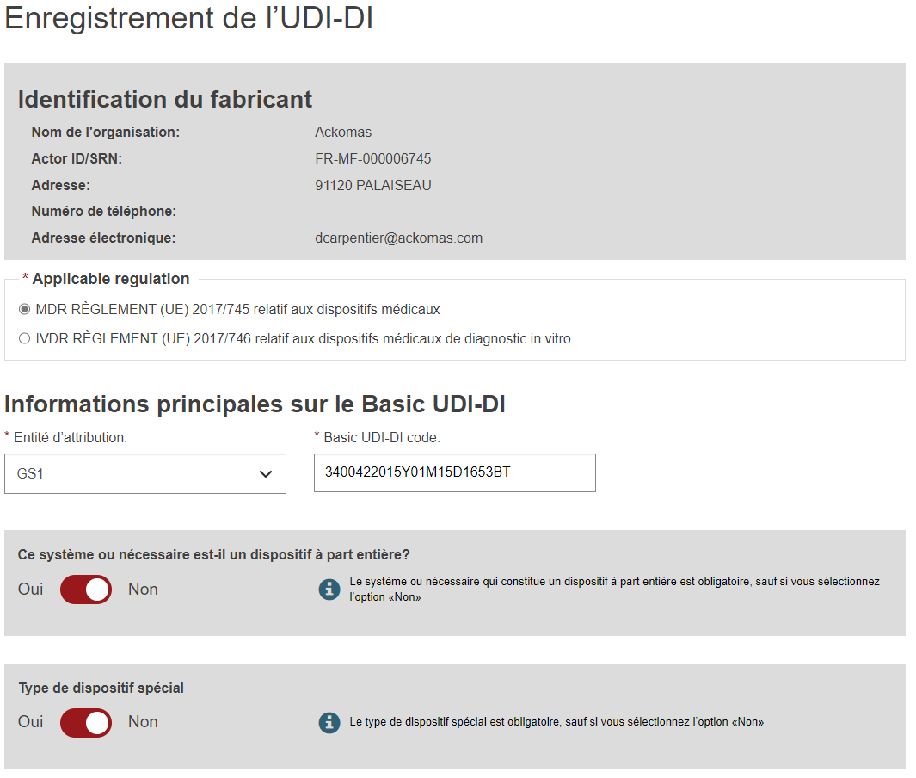
Webinar 2/8 : Manually Entering Your Data into EUDAMED? Step 2: Entering Your Data into EUDAMED (Example 1)
EUDAMED Platform (Creation)
Register a New Basic UDI-DI
Manufacturer / Actor Identification
Select the Applicable Regulation & Begin Entering the Basic UDI-DI
Hidden Attributes That Appear Based on the Response
Système Pack and Procedure (SPP) : NON =>
Special Device? : If YES => Choose Between Software, Lenses…
A False Sense of Obviousness When Ignoring the Documentation; A Simple Click Is Not Always Enough!
Notes:
Now, let's look at the actual data entry process in EUDAMED. I'm not doing a live demo because it could take too long, and I might lose you if I don't use your products or examples.
Everything starts with entering a Basic UDI-DI and at least one UDI-DI. You can't have one without the other, at least during creation.
The Basic UDI-DI is created based on an actor (manufacturer identification).
You choose the applicable regulation, MDR or IVDR, which opens different attributes. This means you won't know all the attributes right away. This point is important because it can apply to many so-called conditional attributes. For example, on this first screen, selecting "No" for System & Procedure Pack opens "Type of Special Device.“
From the start, there's a false sense of simplicity. It seems (what's the word?) intuitive, especially when you're playing in the playground (or test) environment and can enter anything. If you insist on this approach, I recommend not ignoring the documentation and reading it thoroughly beforehand.
Once you get the hang of direct entry, you quickly tire of clicking on many attributes, often to deselect them. You have to repeat this for each Basic UDI-DI and each UDI-DI

Slide 9
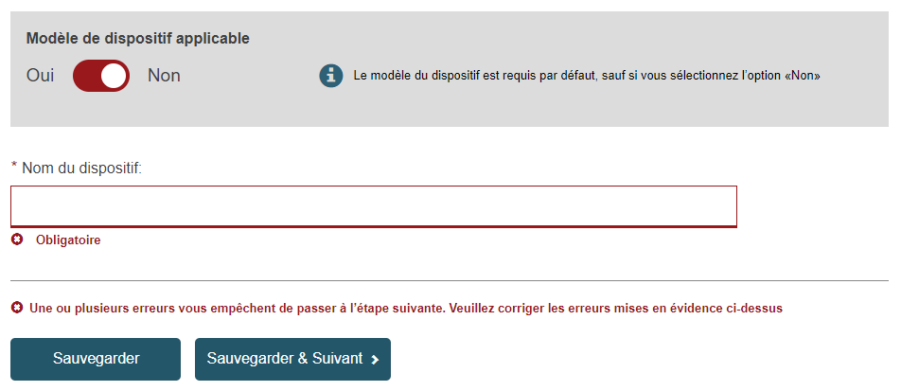
Webinar 2/8 : Manually Entering Your Data into EUDAMED? Step 2: Entering Your Data into EUDAMED (Example 2)
EUDAMED Platform (Creation)
Mandatory Attributes Highlighted
Mandatory Passage on Numerous Attributes
Concise and Tautological Definitions
Use of the Vertical Scroll Bar
Step Mentioned but Poorly Labeled
Step Must Be Completed to Proceed to the Next One
Numerous Data Points to Enter and Know in Advance
Notes:
This isn't a demonstration, and I won't go through all the screens.
However, I've noted a few additional points for you.
You might find more if you try it yourself.
Here they are:
Mandatory attributes are marked with a red asterisk, which I think is quite helpful.
As I mentioned, you have to go through the same attributes each time. It's tedious, especially when you have to check/uncheck them repeatedly.
The online definitions are brief and tautological; I've included an example to make this clearer. In short, you won't learn much from them.
Using the vertical scroll bar is almost mandatory because not all data appears on one screen.
The step you're on is indicated, but the label is not very clear; I'll let you be the judge of that.
Finally, and most importantly, to move to the next step, you must complete all mandatory attributes. That's why your data needs to be ready before you start entering it; otherwise, you'll quickly find yourself making unmanageable back-and-forth trips between data collection and EUDAMED.

Slide 10
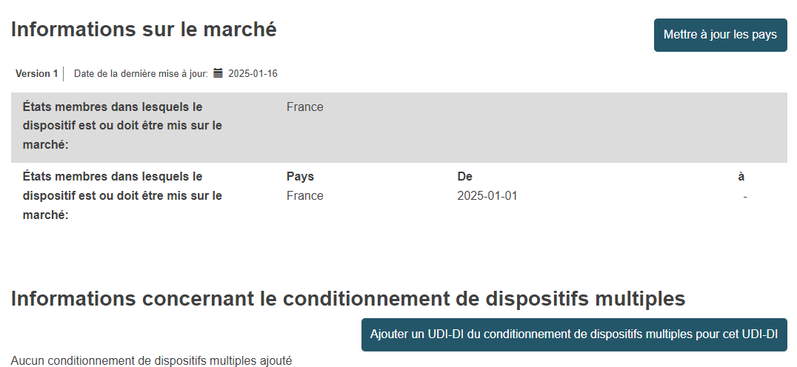
Webinar 2/8 : Manually Entering Your Data into EUDAMED? Step 2: Change Your Data into EUDAMED (Example 3)
EUDAMED Platform (Change)
At Least One Basic UDI-DI and One UDI-DI
Ability to Update Countries and Add a Packaging UDI-DI
Ability to Create a New Version for Some Modifiable Attributes
Entering a Single UDI-DI Takes Time
Notes:
Once the Basic UDI-DI and UDI-DI are created and published (you've gone through all the steps, saved, and published), you can still go back to these records and modify them, at least partially.
For example:
You can add new countries and packaging UDI-DIs.
You can also create a new version to modify some editable attributes, though there are few in EUDAMED.
And, of course, you can add UDI-DIs to an existing Basic UDI-DI.
Keep in mind that entering a UDI-DI generally takes a lot of time, and once published, it's difficult to modify.

Slide 11
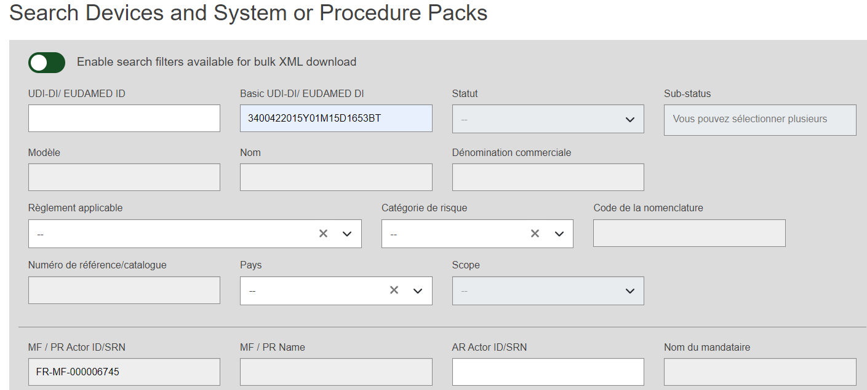
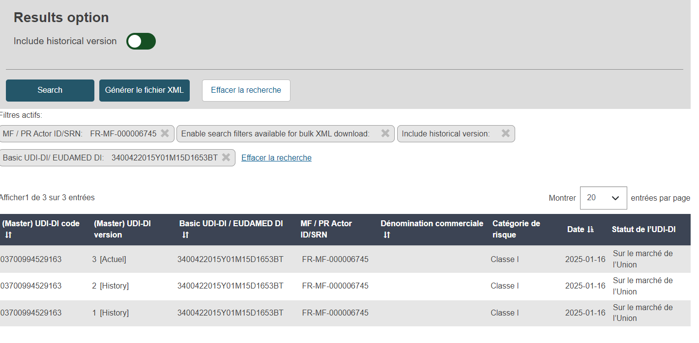
Webinar 2/8 : Manually Entering Your Data into EUDAMED? Step 3: Check Your Data in EUDAMED (Example 4)
EUDAMED Platform (Display)
Ability to Display Data (by Actor)
Filters Available to Select Records and Limit Their Number
Ability to Export Data from the Eudamed Database in XML Format (Not Excel)
Post-Entry Control Is Essential to Correct Data Entry Errors
Notes:
Data entry errors are inherent to manual entry. We've already mentioned this.
That's why I encourage you to check the entered and published data;
otherwise, you'll create inconsistencies between your data in your information system (broadly speaking) and EUDAMED.
These inconsistencies will be hard to justify during a future audit.
It's not always easy, but there are reports available, and you can use some filters. They appear on the screen.
You can theoretically export your data to facilitate bulk checking, but EUDAMED export is only possible in XML format, not Excel. So, you'll need the help of an XML/EUDAMED expert. We'll cover XML files in the next webinar.

Slide 12
Webinar 2/8 : Manually Entering Your Data into EUDAMED? Some Feedback from Experience
Unintuitive Interface (EUDAMED Survey from June 26, 2024)
Mandatory attributes highlighted
Mandatory passage on all attributes
Input across multiple screens
Difficulty following the flow
Notes:
Feedback on direct data entry into the EUDAMED database is quite interesting.
In mid-2024, the commission released the results of a survey.
These results highlight the sometimes difficult experience of many users with EUDAMED (in direct entry, as they were using the playground).
It's also interesting to note that many companies plan to use a 'machine-to-machine' solution and consider hiring a third party like Ackomas. We're far from the fantasy of easy and quick direct entry done internally.
The results of our interviews align with this. I've summarized them as follows:
The interface is generally not very intuitive, even though you might initially think otherwise when you first play with the system and enter random data.
Mandatory attributes are highlighted. This helps distinguish mandatory attributes at creation from optional ones. We advise against entering optional data because modifying it later is often impossible.
The mandatory passage through all attributes is exhausting: attributes are often conditional, making it difficult to have a comprehensive understanding.
Data entry spans multiple screens. Not everything appears on one screen, and you have to use the vertical scroll bar. After a while, you can get lost, especially since the experience with one item doesn't always apply to the next.
Finally, it's hard to follow the data entry flow. Everything goes relatively well if your data entry flow is continuous. But if you're missing data, you're stuck at the current step; you can save your draft, but you can't continue. It's also best not to be interrupted by someone or a phone call. More practically, your eyes start to cross after a while, and the operator begins to make entry errors or lose productivity.
Overall, those who have experienced it for a significant volume of UDI-DIs or GTINs have had a hard time or never finished their task. It's needless to say that picking up an operator's work in such cases is even more tedious.

Slide 13
Webinar 2/8 : Manually Entering Your Data into EUDAMED? Why is such a solution generally not viable?
Increasing regulatory requirements, enhanced security
Proliferation of regulatory databases worldwide
Updating databases is a prerequisite for market entry
Attributes and rules are not identical across all countries.
Data Integrity
ALCOA+
Use Ackomas for immediate use & Prepare for the future
Notes:
Beyond the immediate experience with EUDAMED, you need to consider whether a solution based on manual entry is viable for your company.
Regulatory requirements in healthcare are increasing for enhanced safety.
The general public is not inclined to accept less safety when it comes to their health, even if it sometimes comes at the expense of creativity and innovation.
In any case, it's essential to adapt, as these requirements are strengthening globally, not just in Europe.
Therefore, if regulatory databases multiply worldwide and data must be up-to-date to market products in these regions, manual entry becomes tedious and not very practical. It can even be a real hindrance for the company.
We often think that data quality and integrity are only meant to meet regulatory requirements. However, employees within the company spend a lot of time searching for the right data for their own needs. This applies to specific functions and when exchanging data between company applications or retrieving it from a database or data lake. You're probably familiar with the saying in IT departments: 'garbage in, garbage out.’
In the medical device industry, the product is one of the most important master data. Working on it with regulatory constraints also benefits the company internally by focusing on value-added operations.

Slide 14
Webinar 2/8 : Manually Entering Your Data into EUDAMED? Alternative solutions to manual entry on the EUDAMED platform
Not registering your DM is not an option
Registration schedule: mandatory starting from 2026
Do not wait until the last moment to register your data
Semi-manual solution: Upload XML files into EUDAMED
The real and false advantages of Bulk XML upload (Webinar February 6, 2025).
Automated solution: Machine to Machine (M2M)
A real convenience for the company & a guarantee of reliability and viability (Webinar February 13, 2025).
Notes:
There are alternative solutions to manual and direct entry into EUDAMED, noting that not registering your medical devices is not an option.
The EUDAMED timeline reminds us that information must be entered into EUDAMED starting January 1, 2026.
Don't wait until the last minute to start working on this. The process takes time, and you might end up with sleepless nights and a lot of stress.
There are two alternative solutions that we'll cover in the next two webinars:
A semi-manual solution involving uploading XML files into EUDAMED; some might be tempted by this approach under certain conditions.
The automated or 'Machine to Machine' solution, which offers real ease for the company and, most importantly, guarantees reliability and viability

Slide 15
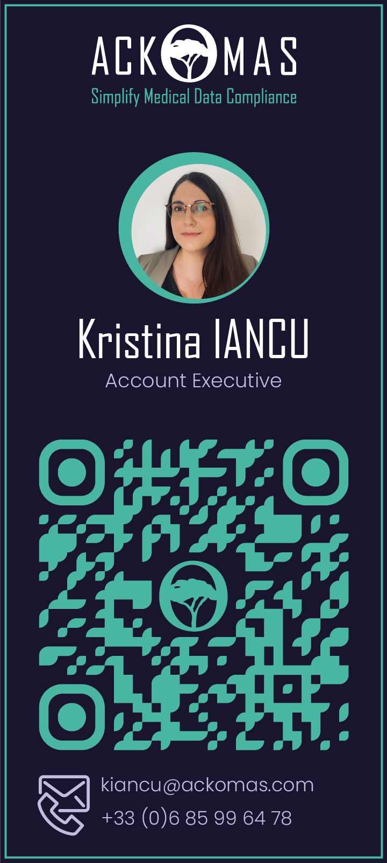
Webinar 2/8 : Manually Entering Your Data into EUDAMED? Next Steps
Next Ackomas Webinar:
3 | Updating XML files into EUDAMED | Feb 13, 25
Receiving the "Eudamed Practical Guide" after the 8 Webinars
Contact Ackomas for your general or specific questions
contact@ackomas.com / +33(0)185416167
Contact our sales team for more information about the Ackomas solution
Cette photo par Auteur inconnu est soumise à la licence CC BY-SA
Cette photo par Auteur inconnu est soumise à la licence CC BY-SA
Notes:
In conclusion,
Thank you for being here today, and I hope to see you at the next webinar, which will cover uploading XML files to EUDAMED.
You will receive the practical EUDAMED guide at the end of the 8 webinars, or maybe even earlier.
Feel free to ask me questions or share your comments or counter-proposals in the coming days if you wish. If they are general, I can provide feedback to everyone during the next webinar.
The Ackomas teams are also available to show you the M2M solution. I'm thinking of Kristina for DACH, Valerio for Italy and Spain and Nicolas for other countries.
Don't hesitate to reach out to them; they are both wonderful.
Finally, let me remind you of our contact details.
Stéphane, Christophe, are there any questions already?
No? Then, thank you again, everyone, and see you soon with pleasure.

